Slide 1
Data Visualization of West Virginia’s Drug Epidemic
Voke Brume, Amy Farson-Ciccone, and Moriah Frazier

Slide 2
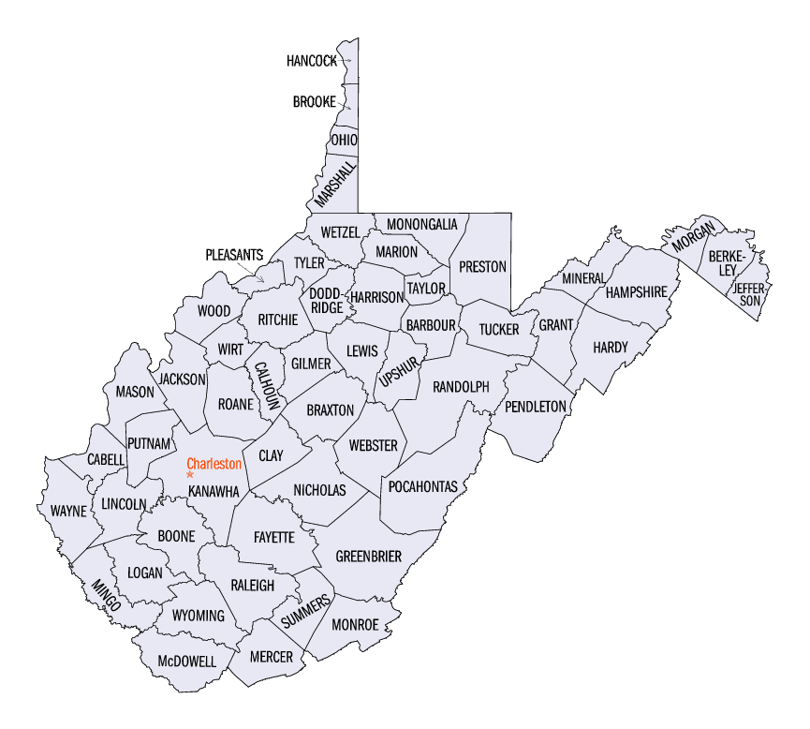
Background
In the United States, drugs have been a serious problem over many decades, but for the general population to understand the root causes, growth, and impact that drugs have within our nation, data visualizations are created.
For several years, West Virginia has had the highest drug overdose mortality rate compared to all of the other states within the United States and has become an epidemic.
By creating a series of interactive data visualizations of the drug epidemic in West Virginia covering many years, users will be able to explore county-level data on the…
Population
Unemployment Rates
Drug Use
Drug Overdose
Life Expectancy
Marijuana Use
Number of Arrests
By developing the interactive data visualization, we hope to bring a better understanding of how severe the drug issue is in WV. Overtime, these visualizations will help explore, monitor, and explain some of these issues to help develop a solution.

Slide 3
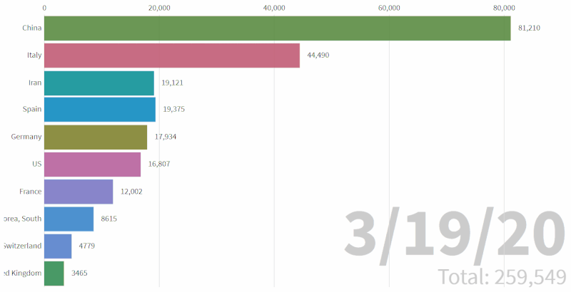
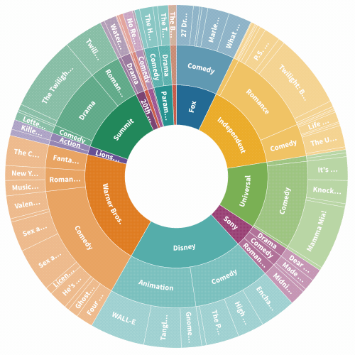
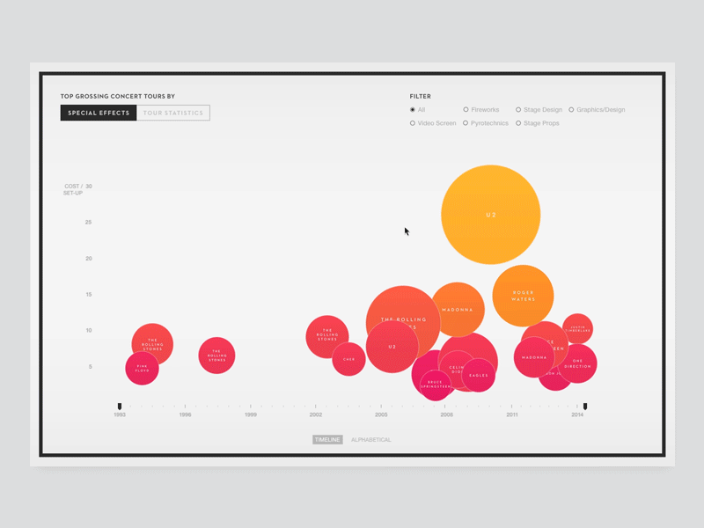
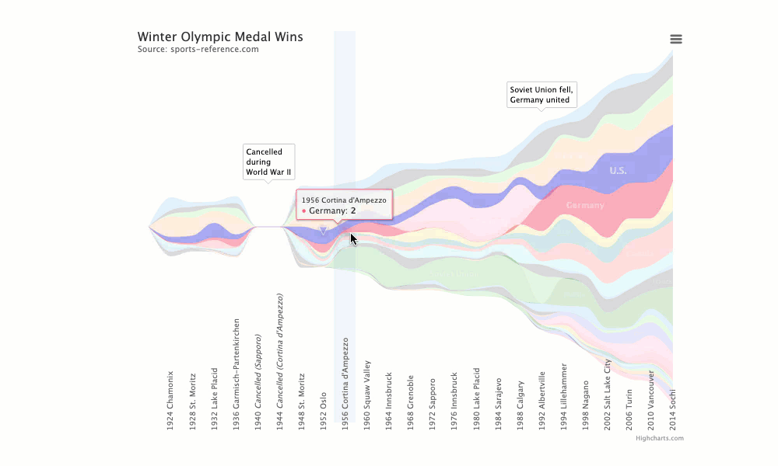
Significance
Visual representation of large sets of data
Everyone doesn’t comprehend or absorb large sets of data (especially numbers) easily and quickly
Large sets of number data can be overwhelming and confusing
Visualization can aid in understanding the data within a glance
Charts
Graphs
maps
Discovering current trends
Save time
Optimize utilization
Aide Decision making and strategy
Data today is quick
Impact: understand severity of drugs have impacted WV
Discover trends
Forecast trends to understand future impacts of current strategies to combat the drug epidemic
Notes:
Big data visualization is a visual representation of large set of data. This is important because not everyone can comprehend and absorb large sets of data (especially numbers) quickly and easily. Especially if the numbers are from large sets of data, the amount of numbers can become overwhelming and confusing. When the data is converted into something that can be seen, the understatement of the data can be done within a glance. This can be done in various forms including charts, graphs, and maps to name a few. This can have a big impact because having the data in a more appealing and concise format can help in identifying trends, can save time, optimize the utilization of the data, aide decision making and overall strategy. Data collected today can come in so quickly that if it is not processed/visualized in the same speed, a lot can be missed (2022, Visme).
The impact our project will have when it is successful, is to be able to understand the severity drugs have impacted West Virginia and possibly discover some trends on why some counties are more affected.

Slide 4
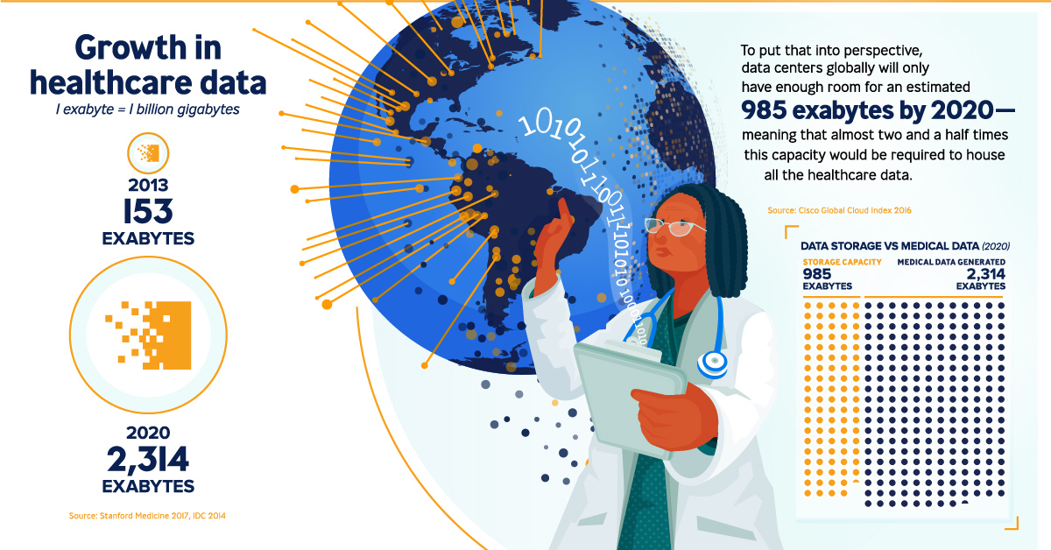
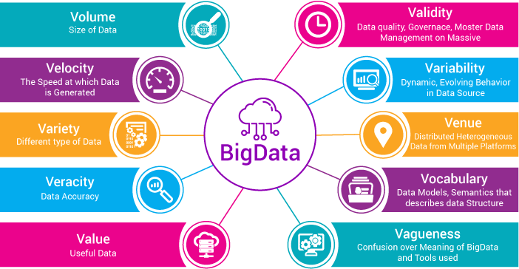
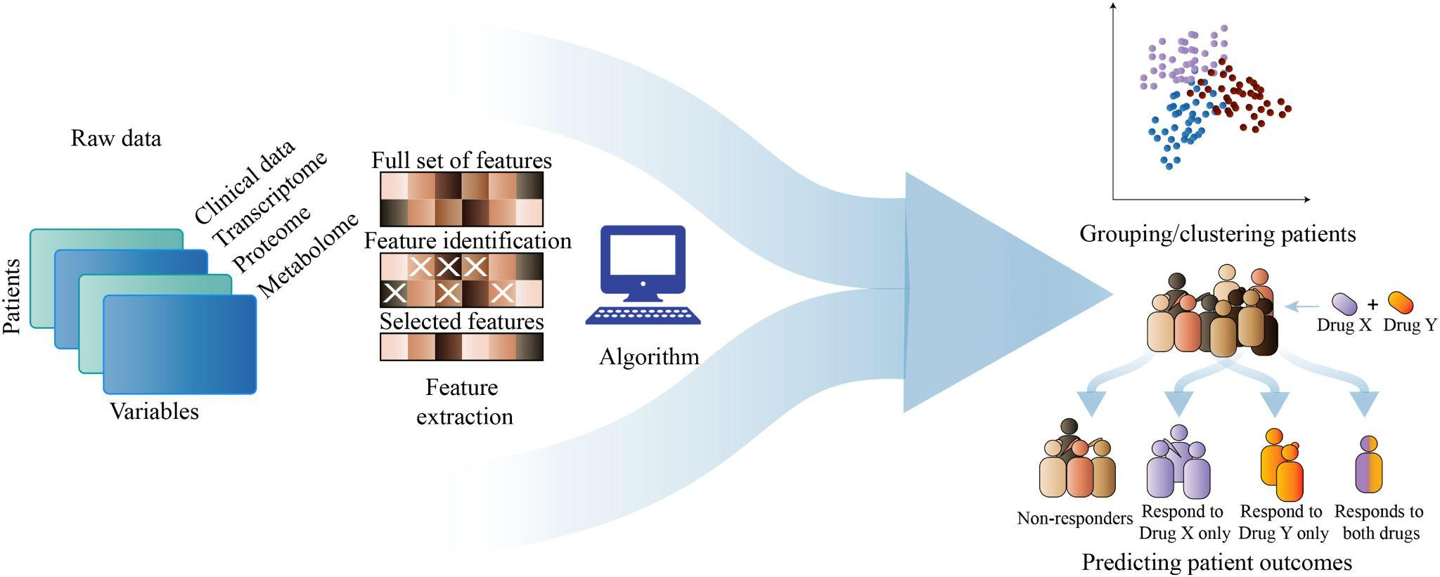
Relationship with Big Data
The widespread adoption of technology and the ever-increasing ability to store large amounts of data have caused researchers to recognize the vital role of Big Data as an opportunity to access empirical evidence in the health sector.
By linking a variety of large datasets from multiple sources, we can comprehensively understand critical events such as the root cause, growth, and impacts of the drug epidemic.
Furthermore, these complex datasets and machine learning can also be used to create forecasting models to estimate the probability of a current conditions or future trends.
Overdose Data to Action (OD2A)

Slide 5
Related Work
Over the past two decades, data visualization has become an increasingly pertinent tool in gaining insights into healthcare data sets.
Koua & Kraak (2004): Recognizes the importance of sequential color schemes to represent geographically distributed health-related data (Choropleth maps) in data-driven knowledge discovery.
Gil-Garcia and Pardo (2005): Identified usability and ease of use as vital technical challenges in healthcare data visualization
Tominski, Schulze-Wollgast, and Schumann (2008): Impressed on the importance of temporal and spatial factors in multivariate data representation
Awalin Sopan, Angela Song-Ie Noh, Sohit Karol, Paul Rosenfeld, Ginnah Lee, and Ben Shneiderman (2012): Proposed Community Health Map that enables users to visualize healthcare data geospatially and in multivariate space.
Benjamin Bearnot MD, John F. Pearson MD, and Jorge A. Rodriguez MD (2018): Utilizes publicly available, crowdsourced data to understand the opioid overdose epidemic by analyzing geospatial trends in discarded needles.
C. K. Leung, Y. Chen, C. S. H. Hoi, S. Shang, Y. Wen and A. Cuzzocrea (2020): Presents a big data visualization and visual analytics tool for visualizing and analyzing COVID-19.
Rui Li (2021): Uses a thematic map utilizing a choropleth design to display confirmed COVID-19 cases at the county level in the state of New York

Slide 6
Our Method
To better understand and grasp the information on West Virginia’s drug epidemic, we plan to create visualizations demonstrating the root causes, growth, and impact for each county. After creating the visualizations, we want to use machine learning to predict future trends within each county in West Virginia.
Platform: Flourish Data Visualization, Tableau, and Python
Datasets: For each county in West Virginia
Population
Economic Condition
Life Expectancy Rate
Crime Rate
Drug Use
Drug Overdose
Marijuana/Non Marijuana Use
Total Arrests
Types of Visualizations:
Time Series
Choropleth Maps
Charts
Dashboard
etc.

Slide 7
Our Method Continued…
To ensure users grasps the information accurately and as quickly as possible, we will be conducting research on the following topics:
The Flourish website and the website’s functions
Visualization methods
The amount of information to include on the visualization
Color schemes
Using Machine Learning to forecast trends

Slide 8
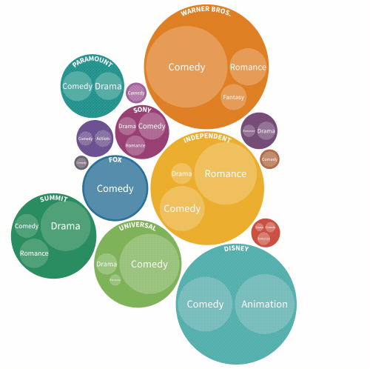
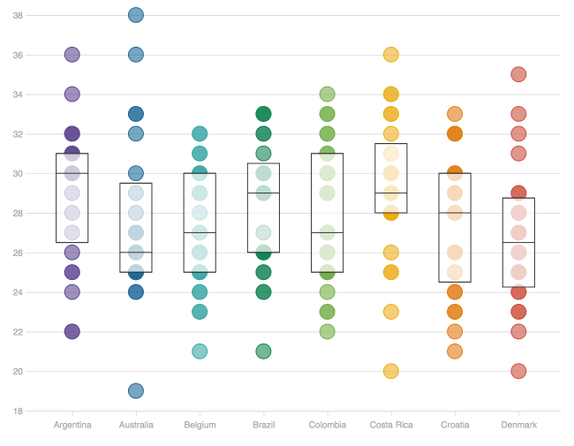
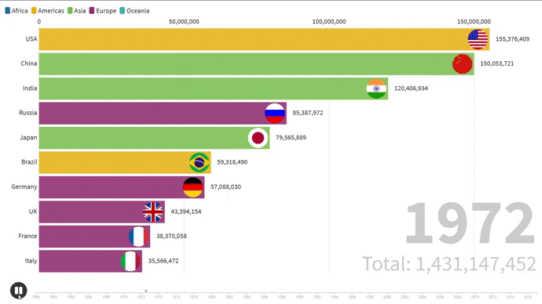
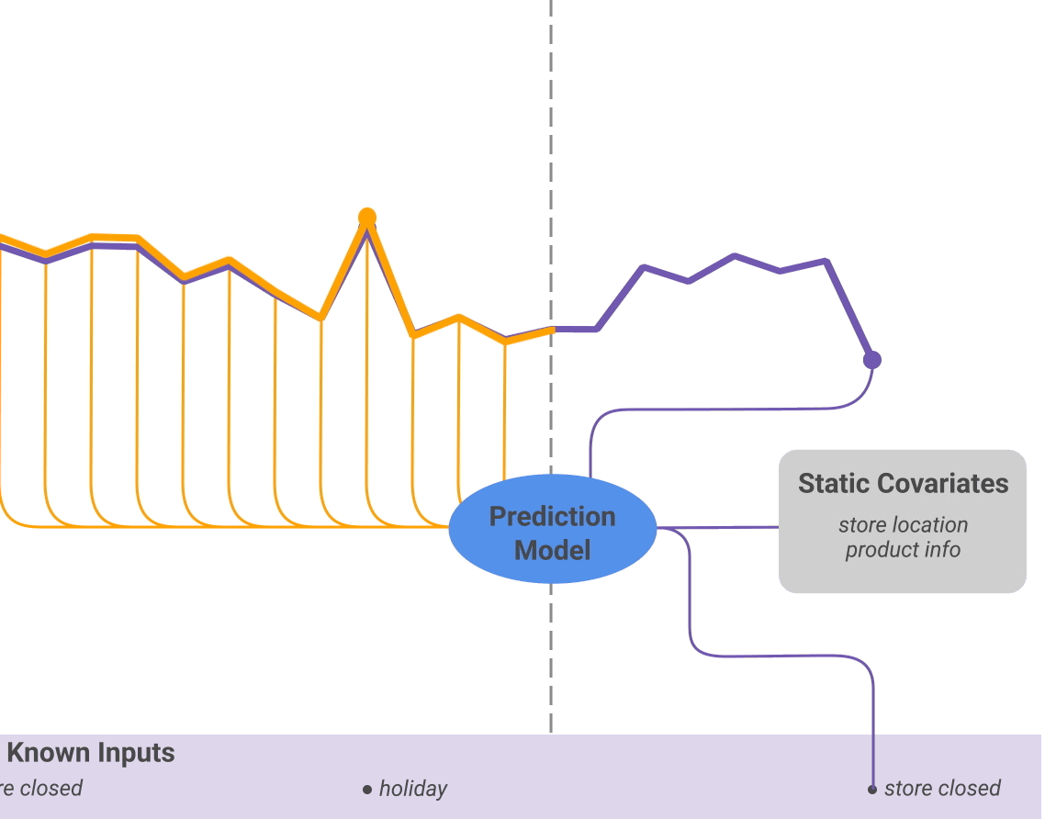
Novelty
Numerous works have employed different data visualization tools for multivariate analysis to explore healthcare data sets on the national level. Unfortunately, few to none exist on the county level that explore these measures:
Deliver intuitive visualizations to explore the root causes, growth, and impact of the drug epidemic in West Virginia.
Expand on the above statement by using machine learning to forecast drug epidemic trends.

Slide 9
Project Flowchart/Work so far
1
2
3
4
5
6
Data Collection
Data Cleaning
Interactive Visualizations
Dashboard
Forecasting Trend
Summarization
Download & Merge Datasets
Data Preprocessing and Exploration
Python & Flourish
Tableau
Long Short-Term Memory (LSTM)

Slide 10
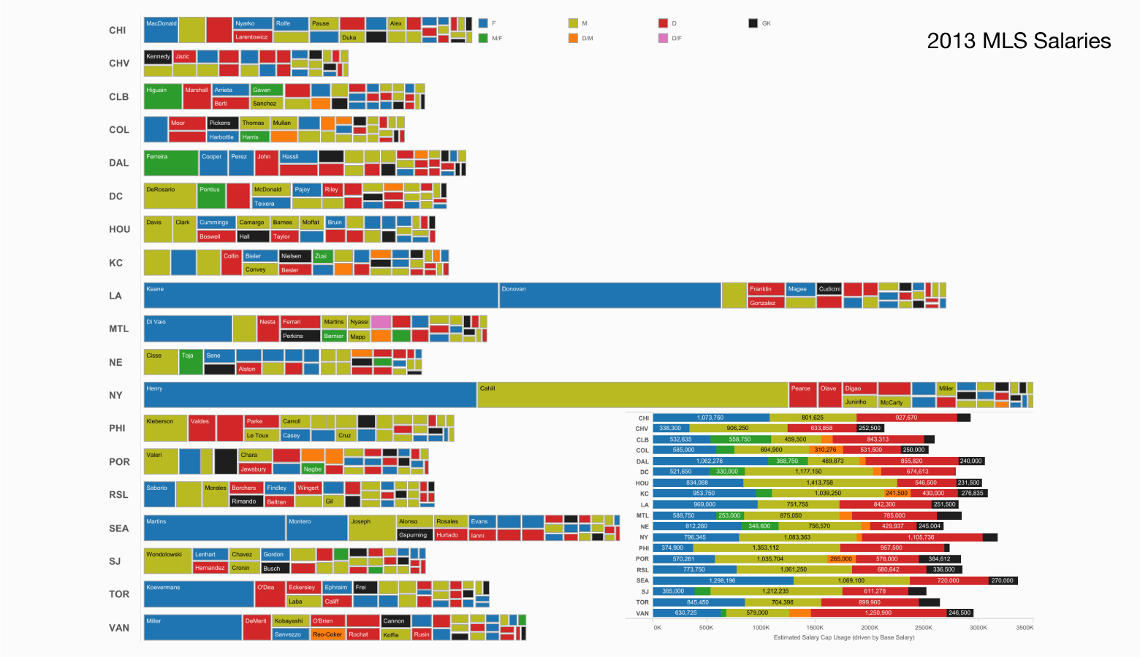
Challenges
By not being careful when designing the visualizations, it can lead to the information being deceptive.
Misleading color contrast
High degrees of color contrast may cause viewers to believe that value disparities are greater than they really are
Too much data
The information becomes overwhelming
Choosing the wrong visualization method
Each visualization method has its own use cases
Selecting the appropriate ML forecasting model

Slide 11
Expected Outcome
Appealing and concise visualization of the root cause, growth, and impacts of the drug epidemic in WV
User friendly interface
Intuitive controls and toggles
Forecast future trends using machine learning
Good model performance measures
Low mean square percentage error
Notes:
We expect to be able to visually display the drug epidemic in West Virginia in various ways. For a couple of examples:
Having a racing bar graph to display the trends of drug usage in each county over a few years
Maps to display ‘hot spots’ or which county has increased usage over a range of years
Also, we maybe able to discover certain trends between the gathered information that may not be noticeable without visualization. For example:
If there is any correlation between unemployment or poverty rates and the usage of drugs

Slide 12

Performance Evaluation
Success:
Having multiple interactive visuals on a dashboard
Visualizations are easily understandable and appealing
Toggle between different data measures
Forecast trends
Notes:
Success for our work will be measured by having multiple different interactive visuals of the different measures of the drug epidemic of WV, the visuals are easy to understand at a glance, the visuals are visually appealing, and the different data measures can be switched between one another. Also, with the data we have, we will be able to implement machine learning to predict future trends

Slide 13
Sources
Awalin Sopan, Angela Song-Ie Noh, Sohit Karol, Paul Rosenfeld, Ginnah Lee, Ben Shneiderman, Community Health Map: A geospatial and multivariate data visualization tool for public health datasets, Government Information Quarterly, Volume 29, Issue 2, 2012, Pages 223-234, ISSN 0740-624X, https://doi.org/10.1016/j.giq.2011.10.002.
“Big Data Visualization: What is it, Tips & Tools (beginner's guide),” Visme Blog, 27-Apr-2022. [Online]. Available: https://visme.co/blog/big-data-visualization/#:~:text=Big%20Data%20Visualization-,What%20is%20Big%20Data%20Visualization%3F,chart%20types%20or%20visual%20representation. [Accessed: 24-Oct-2022].
Li, R. Visualizing COVID-19 information for public: Designs, effectiveness, and preference of thematic maps. Hum Behav & Emerg Tech. 2021; 3: 97 – 106. https://doi.org/10.1002/hbe2.248
M. Bowers, “An overview of common data visualization mistakes” Toptal Design Blog, 20-Oct-2020. [Online]. Available: https://www.toptal.com/designers/ux/data-visualization-mistakes. [Accessed: 24-Oct-2022].
“Office of Drug Control Policy - Data Dashboard” Data Dashboard. [Online]. Available: https://dhhr.wv.gov/office-of-drug-control-policy/datadashboard/Pages/default.aspx. [Accessed: 25-Oct-2022].
“Opioid data analysis and resources” Centers for Disease Control and Prevention, 01-Jun-2022. [Online]. Available: https://www.cdc.gov/opioids/data/analysis-resources.html. [Accessed: 24-Oct-2022].

Slide 14
Questions?

